Slide 1
ARRAYS

Slide 2
Topics
One Dimensional Array
Declaration
Initialization
Multi dimensional Array

Slide 3
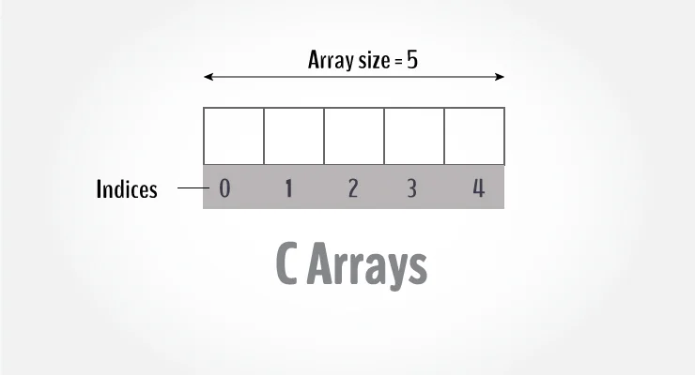
What is an Array ?
An array is a variable that can store multiple values. For example, if you want to store 100 integers, you can create an array for it.
int data[100];Array is a data structure
Represent a collection of data items which have the same data type
Static Memory i.e. memory size once allocated for an array cannot be changed.

Slide 4
Why do we need an array ?

Slide 5
The Problem
Suppose we have 10 numbers to handle.
• Or 20.
• Or 100.
• Where do we store the numbers ?
Use 100 variables ??
• How to tackle this problem?
Solution: – Use arrays.
Arrays are very important in any programming language. They provide a more convenient way of storing variables or a collection of data of a similar data type together instead of storing them separately. Each value of the array will be accessed separately.

Slide 6
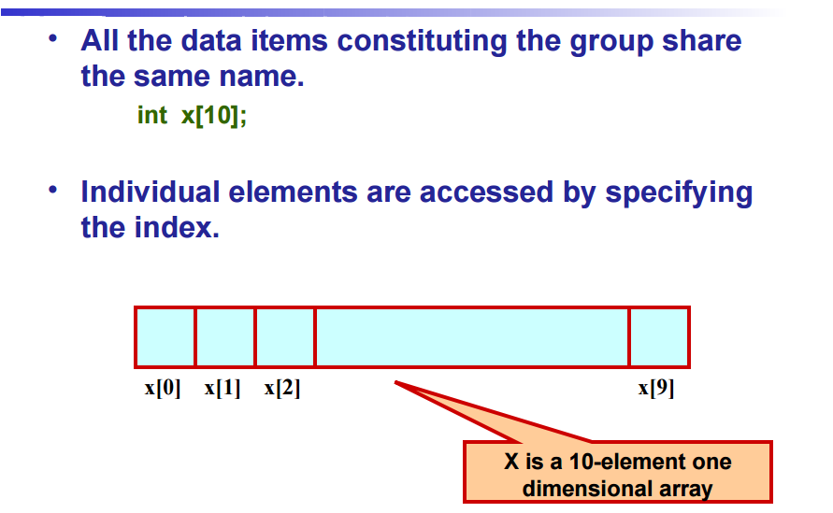
Using Arrays

Slide 7
Syntax of declaring an array
data_type array_name [array_size];
data_type : int,float,double etc.
array_name : name of the variable
array_size : integer values which determines size of the array or memory locations to be allocated to an array
Eg. int a[10];

Slide 8
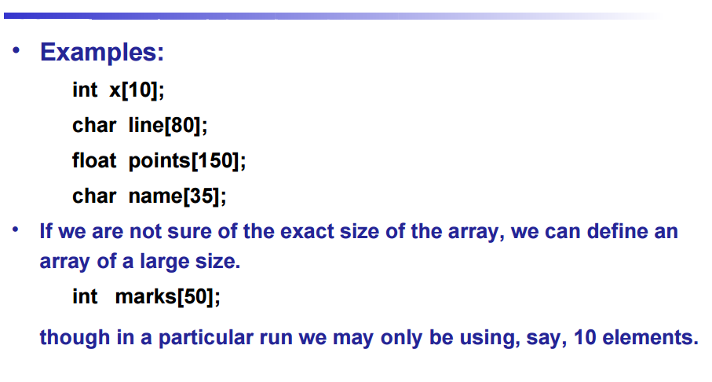
Example of Declaring Array

Slide 9
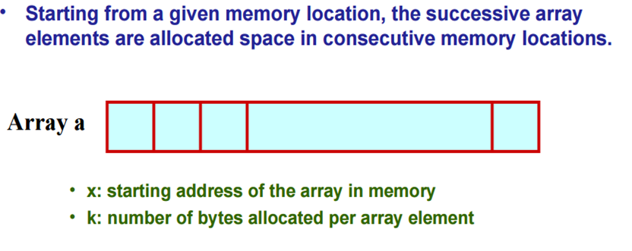
How an array is stored in memory?

Slide 10
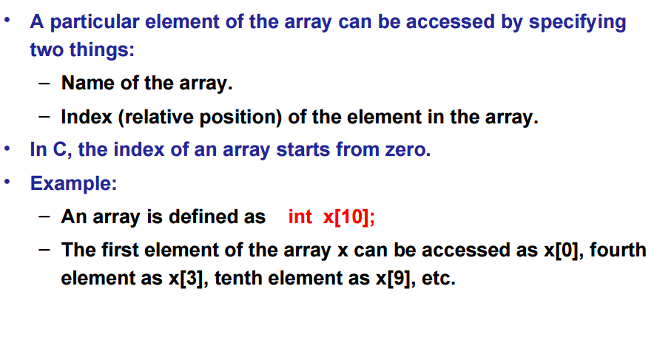
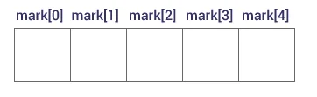
Accessing Array Elements

Slide 11
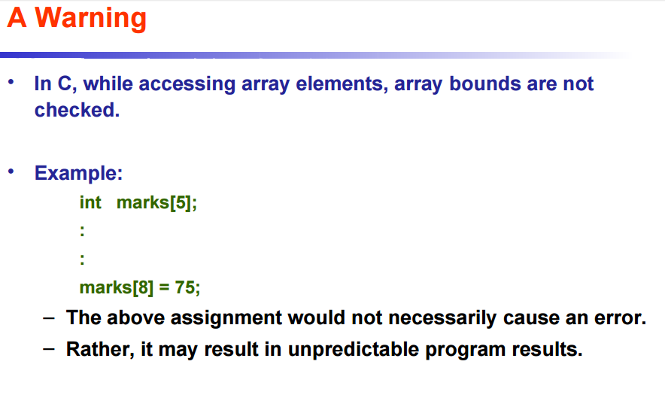

Slide 12
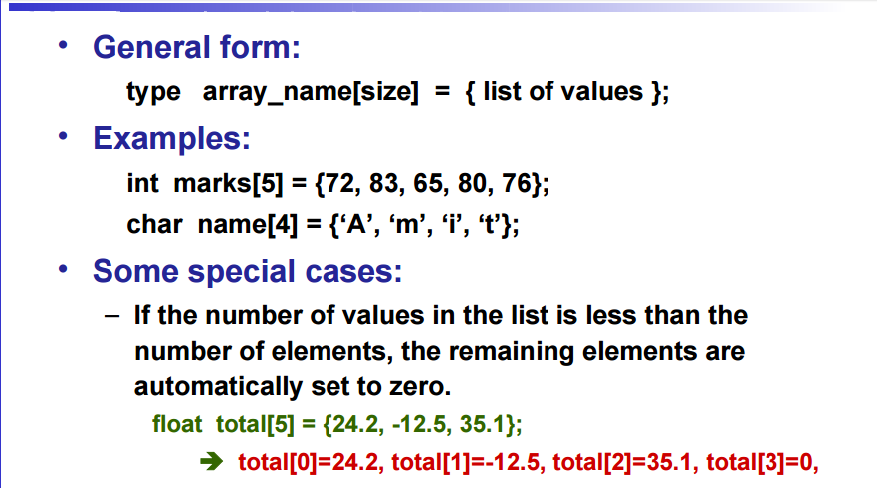
Initialization of Arrays

Slide 13
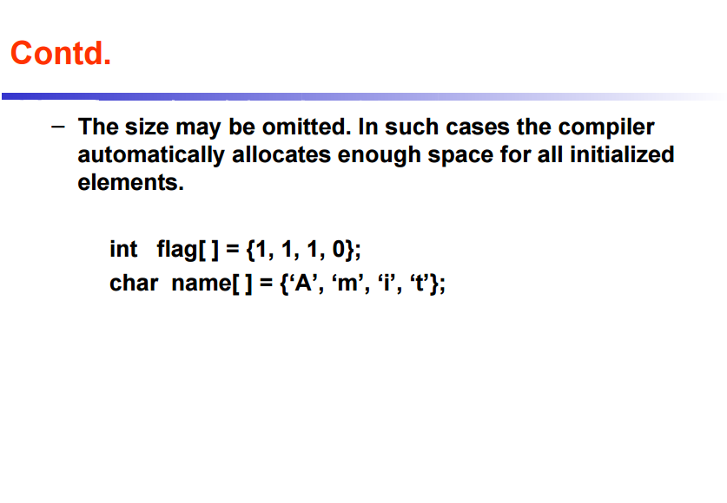

Slide 14
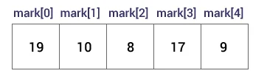
int mark[] = {19, 10, 8, 17, 9};

Slide 15
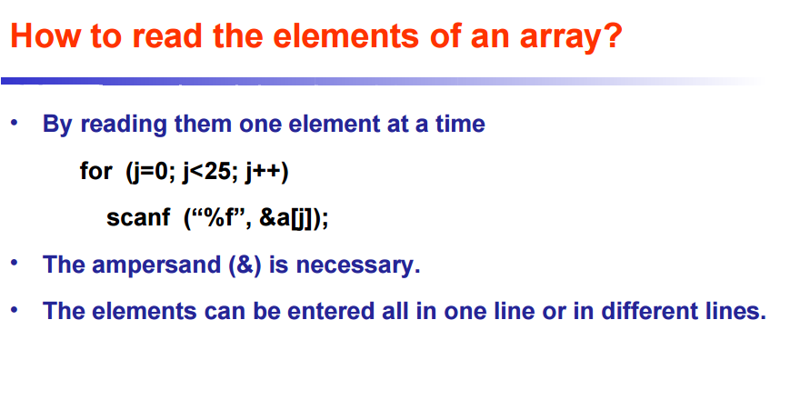

Slide 16
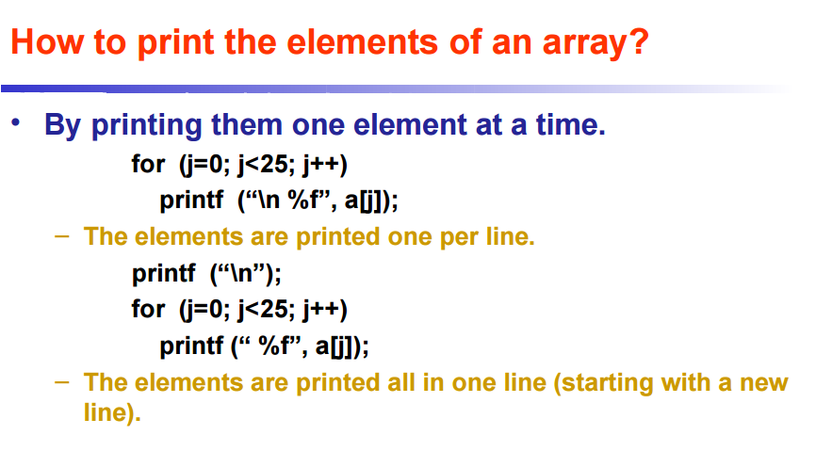

Slide 17
Program to accept ‘n’ integers from user into an array and display them one in each line
#include<stdio.h> int main() { int i, arr[50], num; printf("\nEnter no of elements :"); scanf("%d", &num); //Reading values into Array printf("\nEnter the values :"); for (i = 0; i < num; i++) { scanf("%d", &arr[i]); } //Printing of all elements of array for (i = 0; i < num; i++) { printf("\narr[%d] = %d", i, arr[i]); } return (0); }

Slide 18
Excercise
Write a program to accept ‘n’ integers from the user into an array and display the average of these numbers.
Write a program to accept ‘n’ integers from the user into an array and display the count of even and odd numbers of these.
Write a program to find the largest of ‘n’ numbers taken from user.

Slide 19
Program to find the sum and average of n numbers using arrays
#include <stdio.h>
int main() {
int marks[10], i, n, sum = 0;
double average;
printf("Enter number of elements: ");
scanf("%d", &n);
for(i=0; i < n; ++i) {
printf("Enter number%d: ",i+1);
scanf("%d", &marks[i]);
// adding integers entered by the user to the sum variable
sum += marks[i];
}
}
// explicitly convert sum to double
// then calculate average
average = (double) sum / n;
printf("Average = %.2lf", average);
return 0;
Output:
Enter number of elements: 5
Enter number1: 45
Enter number2: 35
Enter number3: 38
Enter number4: 31
Enter number5: 49
Average = 39.60

Slide 20
Write a program in C to read n number of values in an array and display them in reverse order.
#include <stdio.h>
void main()
{ int i,n,a[100];
printf("Input the number of elements to store in the array :"); scanf("%d",&n);
for(i=0;i<n;i++)
{scanf("%d",&a[i]);
}
printf("\nThe values store into the array are : \n");
for(i=0;i<n;i++)
{ printf("% d",a[i]); }
printf("\n\nThe values store into the array in reverse are :\n");
for(i=n-1;i>=0;i--)
{ printf("% d",a[i]); }
printf("\n\n");
}

Slide 21
Largest element of array
#include <stdio.h>
int main() {
int array[10] = {1, 2, 3, 4, 5, 6, 7, 8, 9, 0};
int i, largest;
largest = array[0];
for(i = 1; i < 10; i++) {
if( largest < array[loop] )
largest = array[loop];
}
printf("Largest element of array is %d", largest);
return 0;
}

Slide 22
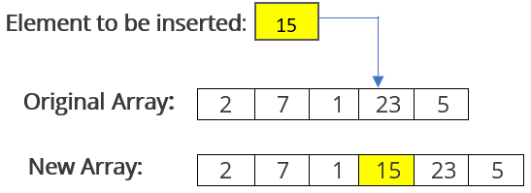
Insert an Element in an Array

Slide 23
#include <stdio.h>
void main()
{
int array[100];
int i, n, x, pos;
printf("Enter the number of elements in the array \n");
scanf("%d", &n);
printf("Enter the elements \n");
for (i = 0; i < n; i++)
{
scanf("%d", &array[i]);
}
printf("Input array elements are: \n");
for (i = 0; i < n; i++)
{
printf("%d ", array[i]);
}
printf("\nEnter the new element to be inserted: ");
scanf("%d", &x);
printf("Enter the position where element is to be inserted: ");
scanf("%d", &pos);
//shift all elements 1 position forward from the place
//where element needs to be inserted
n=n+1;
for(i = n-1; i >= pos; i--)
array[i]=array[i-1];
array[pos-1]=x; //Insert the element x on the specified position
//print the new array
for (i = 0; i < n; i++)
{
printf("%d ", array[i]);
}
}

Slide 24
Searching an element
include <stdio.h>
void main()
{ int num;
int i, keynum, found = 0;
printf("Enter the number of elements ");
scanf("%d", &num);
int array[num];
printf("Enter the elements one by one \n");
for (i = 0; i < num; i++)
{
scanf("%d", &array[i]);
}
printf("Enter the element to be searched ");
scanf("%d", &keynum);
/* Linear search begins */
for (i = 0; i < num ; i++)
{
if (keynum == array[i] )
{
found = 1;
break;
}
}
if (found == 1)
printf("Element is present in the array at position %d",i+1);
else
printf("Element is not present in the array\n");
}

Slide 25
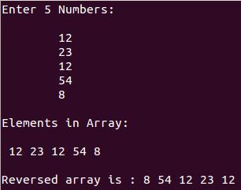
C program to reverse an array.
#include <stdio.h> int main() { int a[5], rev[5], i, j; printf("Enter 5 Numbers:\n\n"); for(i=0; i<5; i++) scanf("%d", &a[i]); printf("\nElements in Array:\n\n"); for(i=0; i<5; i++) printf(" %d",a[i]); j=0; for(i=4; i>=0; i--) { rev[j] = a[i]; j++; } /* Prints the reversed array*/ printf("\n\nReversed array is : "); for(i=0; i<5; i++) printf("%d ", rev[i]); return 0; }

Slide 26
sort
#include <stdio.h> int main() { int a[7],i,j,t; printf("Enter 7 Numbers:\n"); for(i=0;i<7;i++) scanf("%d",&a[i]); for(i=0;i<6;i++) for(j=i+1;j<7;j++) if(a[i]>a[j]) { t=a[i]; a[i]=a[j]; a[j]=t; } printf("\nNumbers in Ascending Order:\n"); for(i=0;i<7;i++) printf("%d ",a[i]); return 0; }

Slide 27
Multidimensional Array
C programming language allows multidimensional arrays. Here is the general form of a multidimensional array declaration −
type name[size1][size2]...[sizeN];
For example, the following declaration creates a three dimensional integer array −
int threedim[5][10][4];

Slide 28
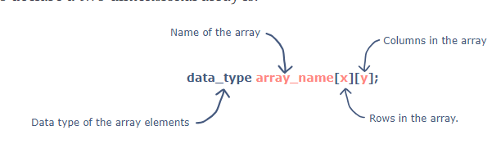
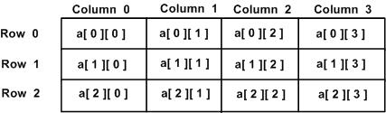
Two-dimensional Arrays
type arrayName [ x ][ y ];

Slide 29
Initializing Two-Dimensional Arrays
int a[3][4] = {0,1,2,3,4,5,6,7,8,9,10,11};
#include <stdio.h>
int main()
{
int my_array[5][3] = {
{1, 2, 3}, //row 1
{4, 5, 6}, //row 2
{7, 8, 9}, //row 3
{10, 11, 12}, //row 4
{13, 14, 15} //row 5
};
}
The inside curly braces are optional, two-dimensional arrays can be declared with or without them.

Slide 30
Two dimensional Array
Matrix Addition
Matrix Multiplication

Slide 31
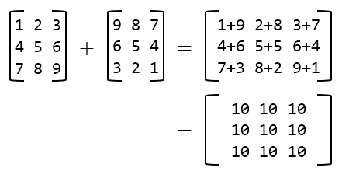
Matrix Addition in C

Slide 32
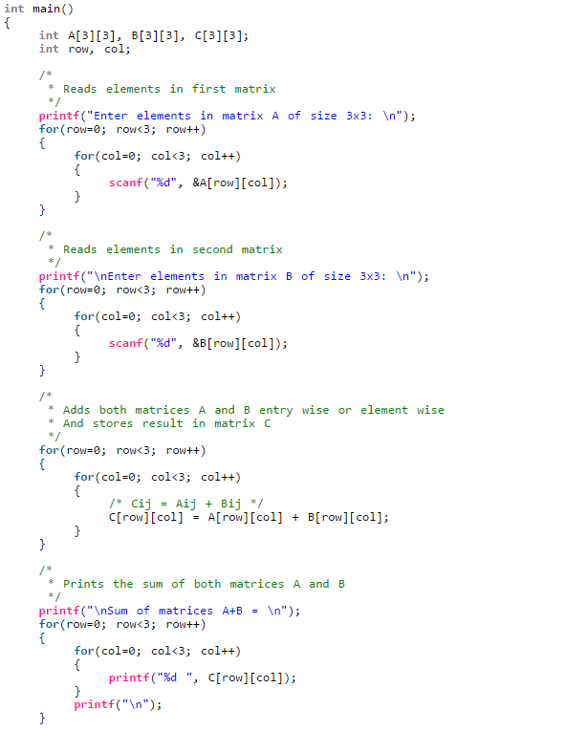

Slide 33
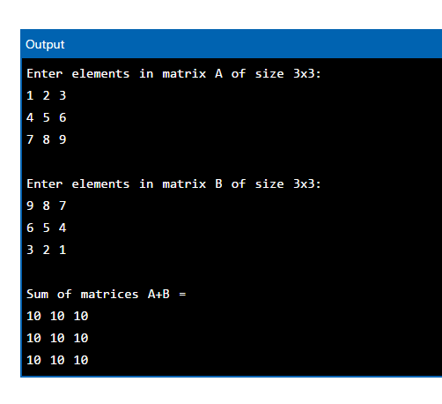

Slide 34
#include <stdio.h>
int main() {
int a[10][10], transpose[10][10], r, c;
printf("Enter rows and columns: ");
scanf("%d %d", &r, &c);
// asssigning elements to the matrix
printf("\nEnter matrix elements:\n");
for (int i = 0; i < r; ++i)
for (int j = 0; j < c; ++j) {
printf("Enter element a%d%d: ", i + 1, j + 1);
scanf("%d", &a[i][j]);
}
// printing the matrix a[][]
printf("\nEntered matrix: \n");
for (int i = 0; i < r; ++i)
for (int j = 0; j < c; ++j) {
printf("%d ", a[i][j]);
if (j == c - 1)
printf("\n");
}
// computing the transpose
for (int i = 0; i < r; ++i)
for (int j = 0; j < c; ++j) {
transpose[j][i] = a[i][j];
}
// printing the transpose
printf("\nTranspose of the matrix:\n");
for (int i = 0; i < c; ++i)
for (int j = 0; j < r; ++j) {
printf("%d ", transpose[i][j]);
if (j == r - 1)
printf("\n");
}
return 0;
}

Slide 35
Lower Triangular
printf("\nLower Triangular Elements :\n");
for(i=0;i<=2;i++)
{
for(j=0;j<=2;j++)
{
if(i>=j)
{
printf("%d ",a[i][j]);
s=s+a[i][j];
}
}
printf("\n");
}
printf("\nSum of Lower Triangular Elements = %d",s);
return 0;
}
#include <stdio.h>
int main()
{
int a[3][3],i,j,s=0;
printf("Enter Elements for 3*3 Matrix:\n\n");
for(i=0;i<=2;i++)
for(j=0;j<=2;j++)
{
scanf("%d",&a[i][j]);
}
printf("\n3*3 Matrix :\n\n");
for(i=0;i<=2;i++)
{
for(j=0;j<=2;j++)
{
printf("%d ",a[i][j]);
}
printf("\n");
}

Slide 36
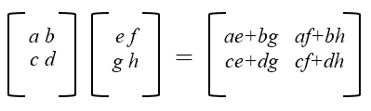
Matrix Multiplication

Slide 37
Matrix Multiplication
If matrix 1 = 1 2 3 4 5 6 7 8 9 And matrix 2 = 9 8 7 6 5 4 3 2 1 Product of both matrices = 30 24 18 84 69 54 138 114 90

Slide 38
A X B
A= 3 0 B= 4 7
1 1 6 8
5 2
A x B=
3(4)+0(6), 3(7)+0(8)
1(4)+1(6), 1(7)+1(8)
5(4)+2(6), 5(7)+2(8)
= 12 21
10 15
32 51

Slide 39
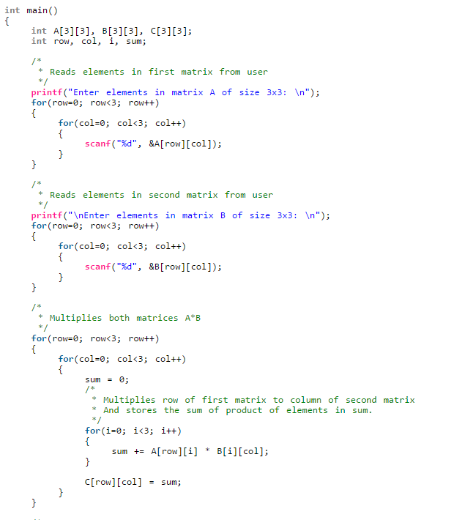

Slide 40
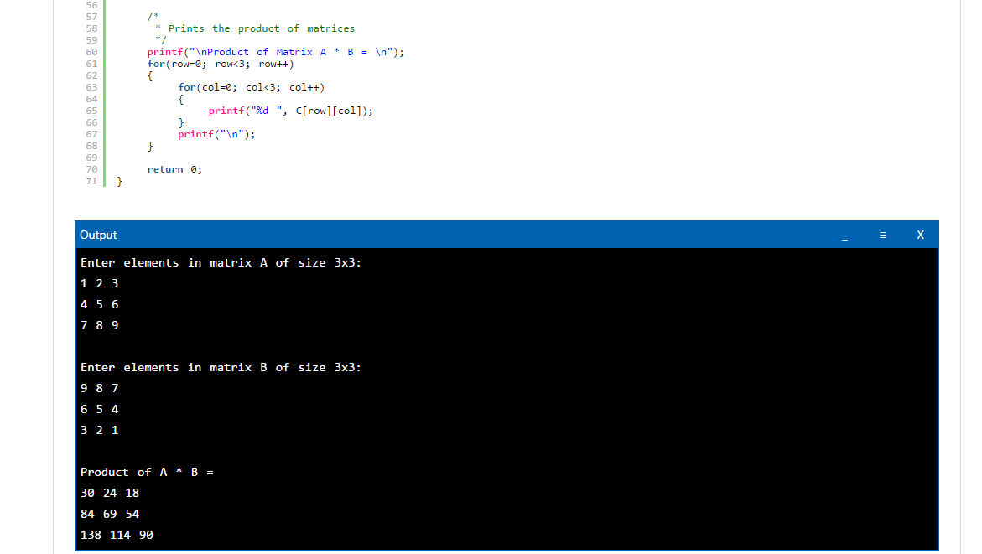

Slide 41
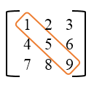
C program to find sum of main diagonal elements of a matrix
for(row=0; row<SIZE; row++)
{
sum = sum + A[row][row];
}

Slide 42
Program to check matrix equality
isEqual = 1;
for(row=0; row<SIZE; row++)
{
for(col=0; col<SIZE; col++)
{
if(A[row][col] != B[row][col])
{
isEqual = 0;
break;
}
}
}
/*
* Checks the value of isEqual
* As per our assumption if isEqual contains 1 means both are equal
* If it contains 0 means both are not equal
*/
if(isEqual == 1)
{
printf("\nMatrix A is equal to Matrix B");
}
else
{
printf("\nMatrix A is not equal to Matrix B");
}
return 0;
}
#include <stdio.h>
#define SIZE 3 // Matrix size
int main()
{ int A[SIZE][SIZE];
int B[SIZE][SIZE];
int row, col, isEqual;
printf("Enter elements in matrix A of size %dx%d: \n", SIZE, SIZE);
for(row=0; row<SIZE; row++)
{
for(col=0; col<SIZE; col++)
{
scanf("%d", &A[row][col]);
}
}
printf("\nEnter elements in matrix B of size %dx%d: \n");
for(row=0; row<SIZE; row++)
{
for(col=0; col<SIZE; col++)
{
scanf("%d", &B[row][col]);
}
}

Slide 43
Program to find sum of rows and columns of matrix
/* Calculate sum of elements of each row of matrix */
for(row=0; row<SIZE; row++)
{
sum = 0;
for(col=0; col<SIZE; col++)
{
sum += A[row][col];
}
printf("Sum of elements of Row %d = %d\n", row+1, sum);
}
/* Find sum of elements of each columns of matrix */
for(row=0; row<SIZE; row++)
{
sum = 0;
for(col=0; col<SIZE; col++)
{
sum += A[col][row];
}
Enter elements in matrix of size 3x3:
1 2 3
4 5 6
7 8 9
Sum of elements of Row 1 = 6
Sum of elements of Row 2 = 15
Sum of elements of Row 3 = 24
Sum of elements of Column 1 = 12
Sum of elements of Column 2 = 15
Sum of elements of Column 3 = 18

Slide 44
Pass Individual Array Elements
#include <stdio.h>
void display(int age1, int age2) {
printf("%d\n", age1);
printf("%d\n", age2);
}
int main() {
int ageArray[] = {2, 8, 4, 12};
// pass second and third elements to display()
display(ageArray[1], ageArray[2]);
return 0;
}
Output
8
4

Slide 45
Pass Arrays to Functions
#include <stdio.h>
float calculateSum(float num[]);
int main() {
float result, num[] = {23.4, 55, 22.6, 3, 40.5, 18};
// num array is passed to calculateSum()
result = calculateSum(num);
printf("Result = %.2f", result);
return 0;
}
float calculateSum(float num[]) {
float sum = 0.0;
for (int i = 0; i < 6; ++i) {
sum += num[i];
}
return sum;
}
Output
Result = 162.50

Slide 46
Pass Multidimensional Arrays to a Function
#include <stdio.h>
void displayNumbers(int num[2][2]);
int main() {
int num[2][2];
printf("Enter 4 numbers:\n");
for (int i = 0; i < 2; ++i) {
for (int j = 0; j < 2; ++j) {
scanf("%d", &num[i][j]);
}
}
// pass multi-dimensional array to a function
displayNumbers(num);
return 0;
}
void displayNumbers(int num[2][2]) {
printf("Displaying:\n");
for (int i = 0; i < 2; ++i) {
for (int j = 0; j < 2; ++j) {
printf("%d\n", num[i][j]);
}
}
}
Output
Enter 4 numbers:
2
3
4
5
Displaying:
2
3
4
5

